Slide 1

Text Style Transfer
Group No : 3
Rushabh Kakadiya
Jaimis Miyani
Param Mehta
SEP 775:Introduction to Computational Natural Language Processing

Slide 2
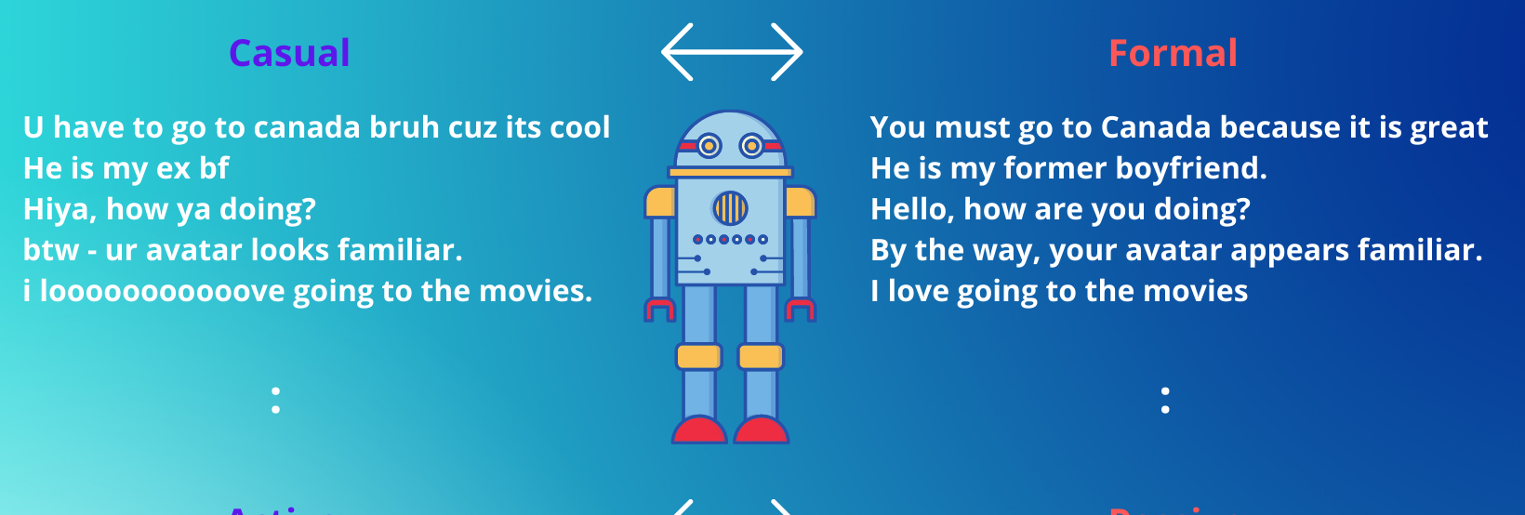
Objective
Develop a system that leverages Natural Language Processing techniques for the purpose of converting informal English text into formal English text.

Slide 3

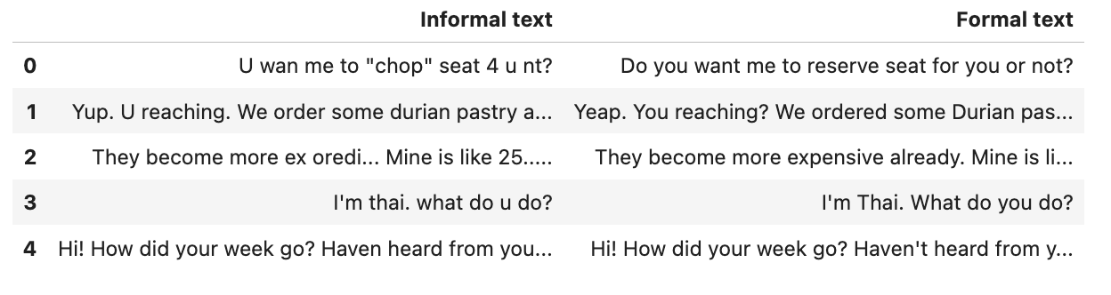
Dataset Information
The NUS Social Media Text Normalization and Translation Corpus provides a solution to the scarcity of publicly available normalized datasets. It consists of 2,000 messages randomly selected from the NUS English SMS corpus.
The Dataset is tailored for text normalization and translation tasks, and is structured with two distinct columns:

Slide 4
Dataset Preprocessing
Converted Dataset to Pandas Dataframe
Augmenting the Dataset
Creating Encoder and Decoder Inputs for model training
Splitting the data into training and validation

Slide 5
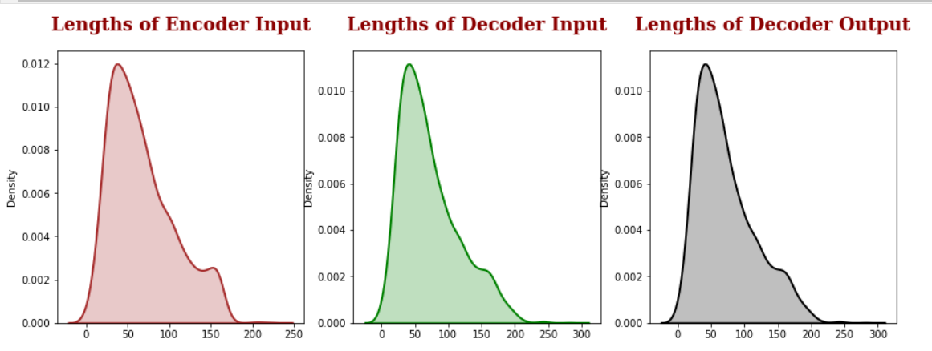
Lenght of Encoder-Decoder Input/Output
Filtering out the sentences which has length more then 200 as most of the sentences have average length of 50.

Slide 6
Padding Data
Encoded the sentences into numerical IDs replacing words using the previously trained tokenizers for both informal and formal text.
Padded the sequences to ensure uniform length for all sentences.
Tokenizing Data
Tokenized data with preservation of case and excluded common punctuations like .,?!:;
Introduced ‘>’ token at the end of the first sentence in the formal data.
Saved the tokenizers for later use

Slide 7
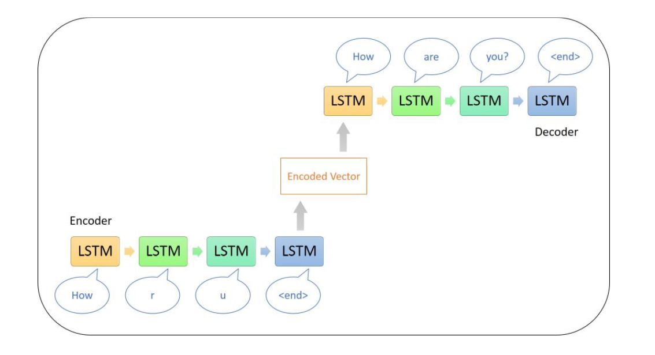
Simple Encoder-Decoder

Slide 8
Designing Model
Architecture
Encoder : Processes the input sequence and generates a hidden representation.
Decoder: Uses the encoded representation and its own internal state to predict the target sequence token-by-token.
Output Layer: A dense layer with SoftMax activation is applied to the decoder's output.

Slide 9
Encoder
Decoder
Embedding Layer: Maps words to vectors, handles variable-length inputs with zero-padding.
First LSTM Layer: Processes sequences, maintains temporal dependencies, returns sequences and states.
Second LSTM Layer: Further refines sequence encoding, captures deeper context, outputs final states.
Embedding Initialization: Converts token indices into dense vectors, optimized for the decoder's vocabulary.
LSTM Configuration: Single LSTM layer designed to generate output sequences, maintaining state across timesteps.
Sequence Decoding: Embeds input sequence then processes it through LSTM to produce output sequence and states.

Slide 10
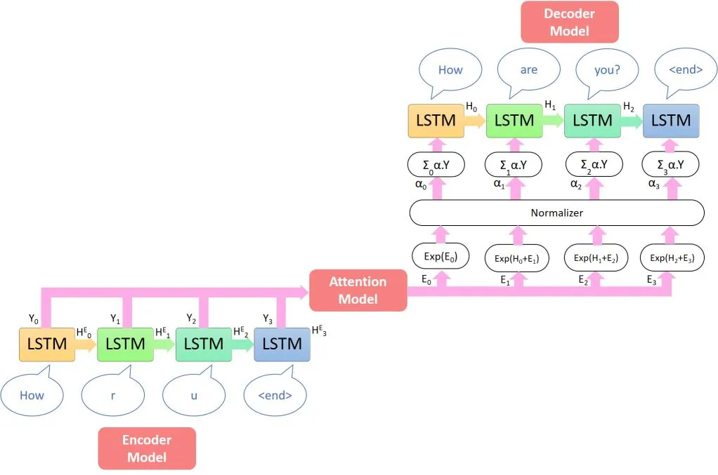
Attention Model

Slide 11
Attention Based Model
Encoder
Timestep Decoder
Initializes Parameters: Sets vocabulary size, embedding dimension, LSTM size.
Embedding Layer: Conditional initialization with/without pre-trained matrix.
LSTM Layers: Two LSTM layers for sequential processing.
Attention Mechanism: Computes context vector from encoder outputs.
Output Generation: Dense layer produces output vocabulary-sized vectors.

Slide 12
Decoder
Attention Mechanism: It uses an attention mechanism (through Timestep Decoder), which allows the model to focus on different parts of the encoder's output while generating each token in the sequence.
Timestep Processing: Processes one timestep at a time through the Timestep Decoder, allowing for more nuanced generation based on the encoder's output and previously generated tokens.

Slide 13
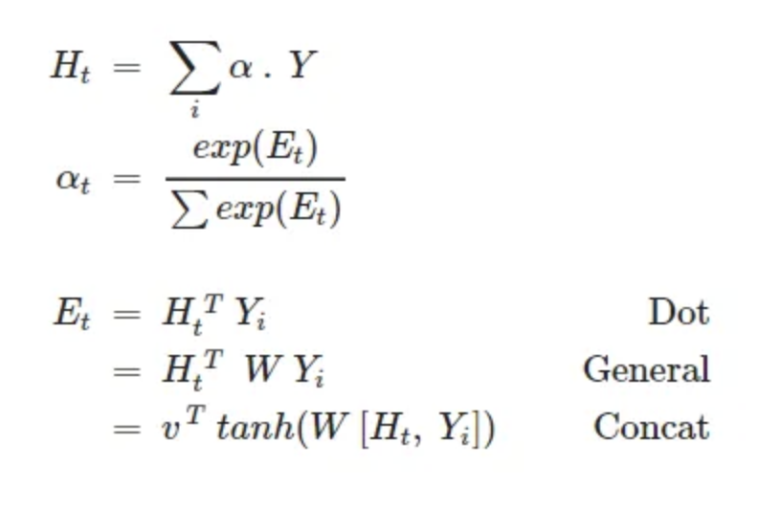
Attention Mechanism
Inputs: Takes decoder hidden state and encoder outputs as inputs.
Scoring Functions:
Dot Product: Measures similarity between decoder hidden state and encoder outputs using dot product.
General: Applies linear transformation to encoder outputs and computes dot product with decoder hidden state.
Concatenative: Concatenates decoder hidden state and encoder outputs, applies linear transformations, and computes dot product.
Context Vector: Obtains context vector by weighting encoder outputs based on attention scores.
Attention Weights: Represents importance of each encoder output for the current decoding step through Softmax scores.
Implementation: Utilizes Dense layers for parameter initialization and matrix operations for scoring computations.
Output: Provides context vector and attention weights for further processing in the model.

Slide 14
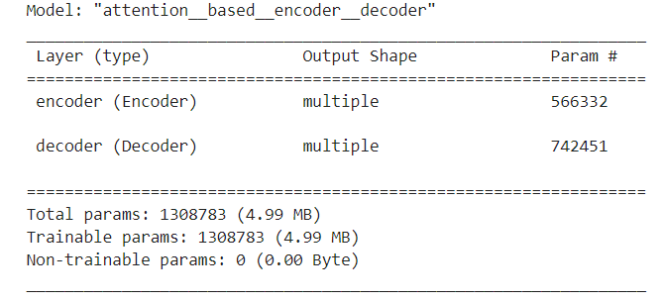
Training the model using Dot Scoring
Definition:
The dot scoring function computes the similarity between the decoder hidden state and encoder outputs by taking the dot product between them. It's used in attention mechanisms to determine the relevance of each encoder output to the current decoding step. This function facilitates focusing the model's attention on pertinent parts of the input sequence during sequence generation.

Slide 15
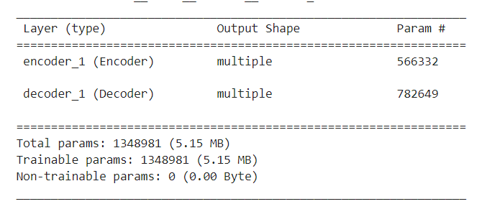
Training the model using General Scoring
Definition:
The general scoring function computes the similarity between the decoder's hidden state and the encoder's outputs using a trainable weight matrix. This allows the model to learn the relevance of each encoder output for the current decoding step, aiding in attention-based sequence generation..

Slide 16
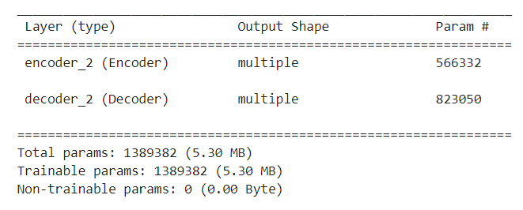
Training the model using Concat Scoring
Definition:
The concat scoring function combines the decoder's hidden state with each encoder output, passing the result through a dense layer with a tanh activation. This allows the model to learn complex interactions between the decoder and encoder states, enhancing the attention mechanism's effectiveness in sequence-to-sequence tasks.

Slide 17
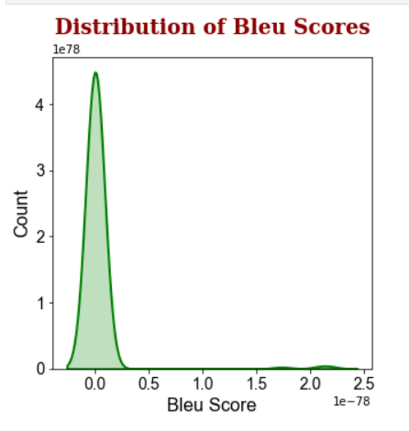
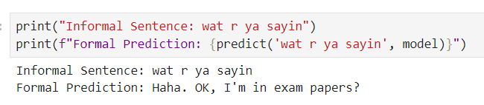
Results:
Simple Encoder-Decoder Model
Mean BLEU score
3.1277541302808807e-80a

Slide 18
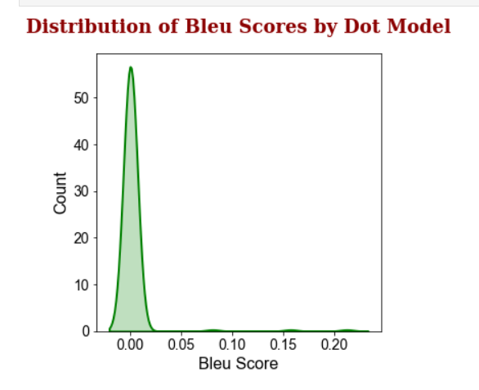
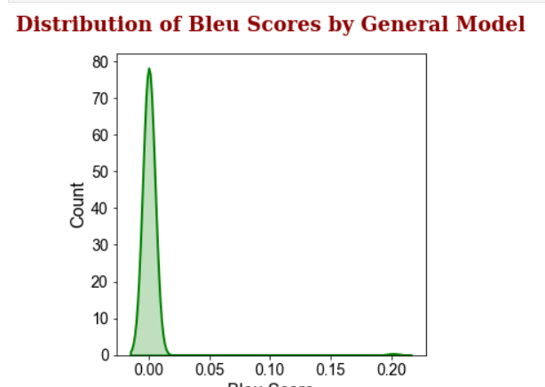
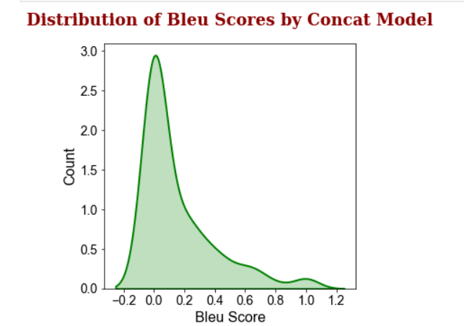
Attention Based Model

Slide 19
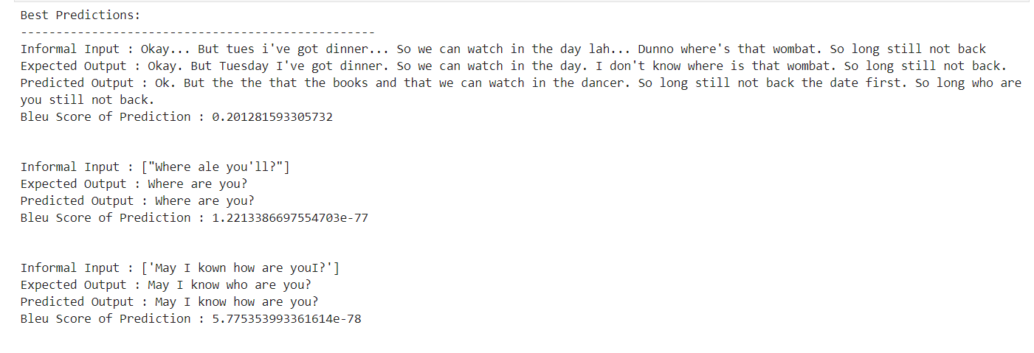
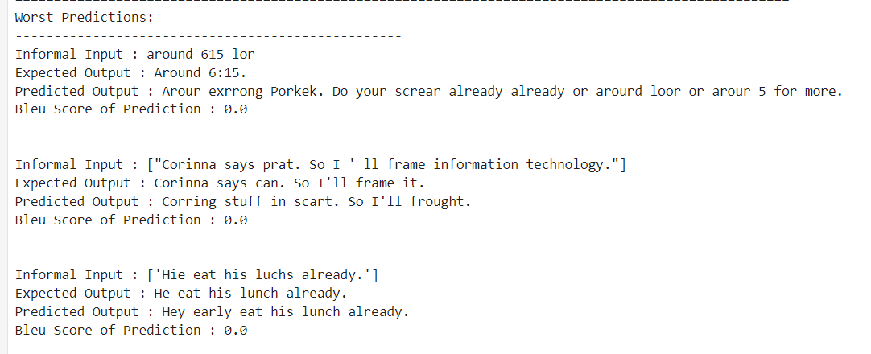
Error Analysis

Slide 20

Future Improvements
Train the model on larger datasets
Use any pretrained model and apply LoRA technique
Integration of Contextual Embeddings

Slide 21

THANK YOU

